Slide 1

Omar Shaaban

Slide 2



Roadmap
Business Understanding
Exploratory data analysis (EDA)
Modelling
findings
Actions to do

Slide 3
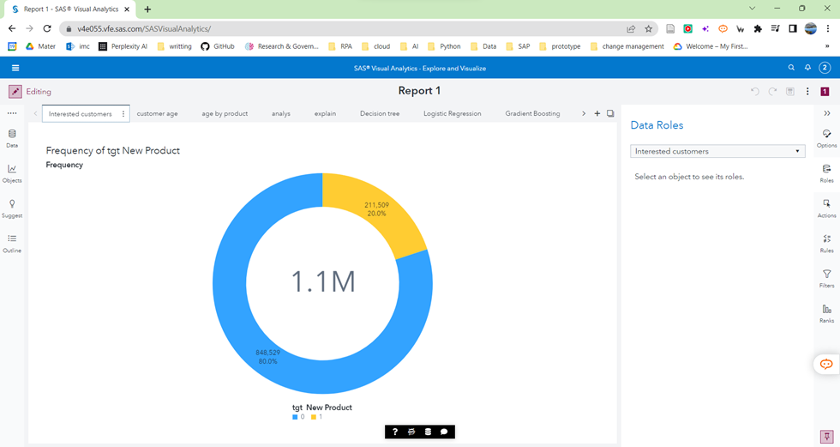
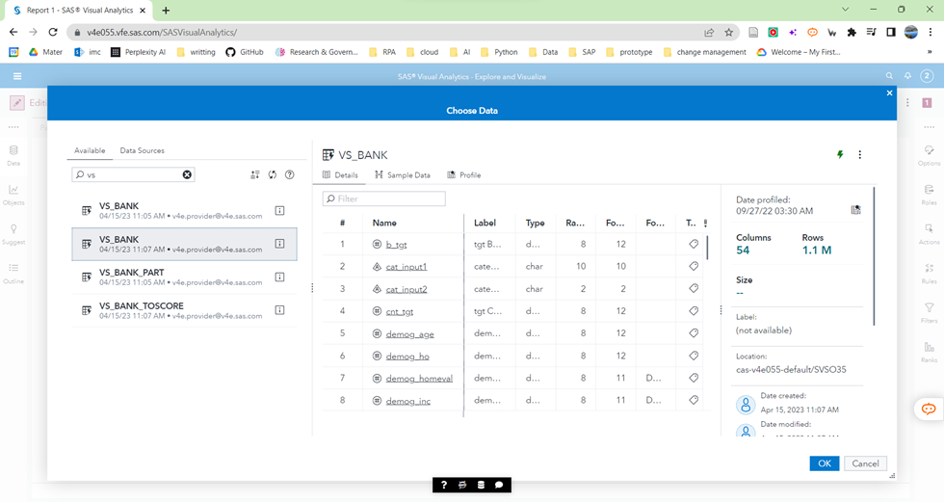
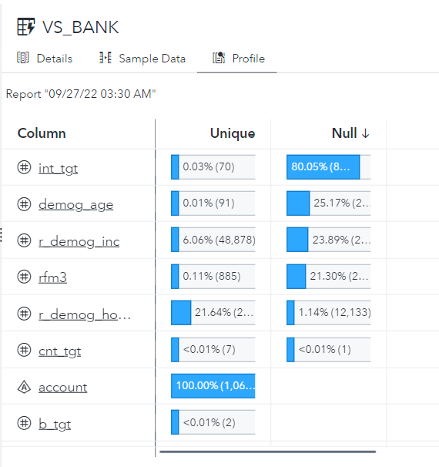
EDA
Business Objectives: Clearly define the goals and challenges of the new digital product launch. Data Exploration: Gather relevant data sources and explore variables and data quality. Feature Selection: Identify influential variables related to purchase behavior. Relationship Analysis: Analyze relationships and correlations among variables using statistical techniques. Association Analysis: Uncover patterns and associations between variables.
Business Understanding
Exploratory data analysis (EDA)
Modelling
findings
Gain from actions

Slide 4
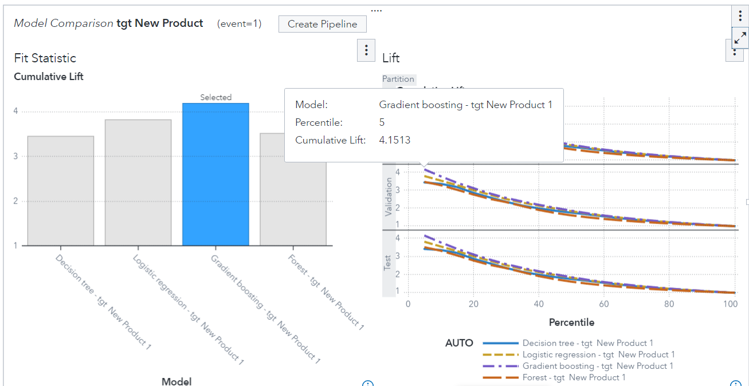
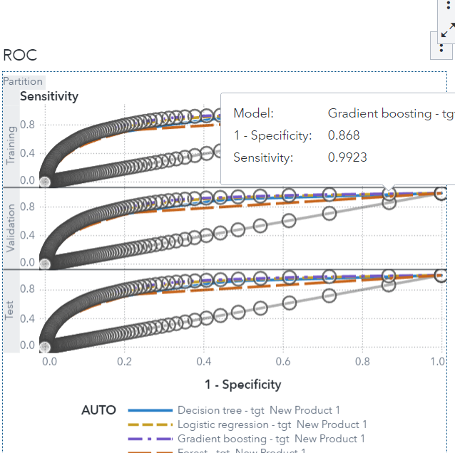
Modeling
Variable Selection: Identify key variables influencing the response target (purchase behavior). Data Partitioning: Split the dataset into training, testing, and validation sets. Classification Models: Utilize decision tree, linear regression, random forest, and gradient boosting models. Model Evaluation: Compare models using performance metrics like lift and ROC. Champion Model: Select the best-performing model, in this case, Gradient Boosting, as the champion model. With cumulative Lift 4,15 and the ROC sensitivity
Business Understanding
Exploratory data analysis (EDA)
Modelling
findings
Gain from actions

Slide 5
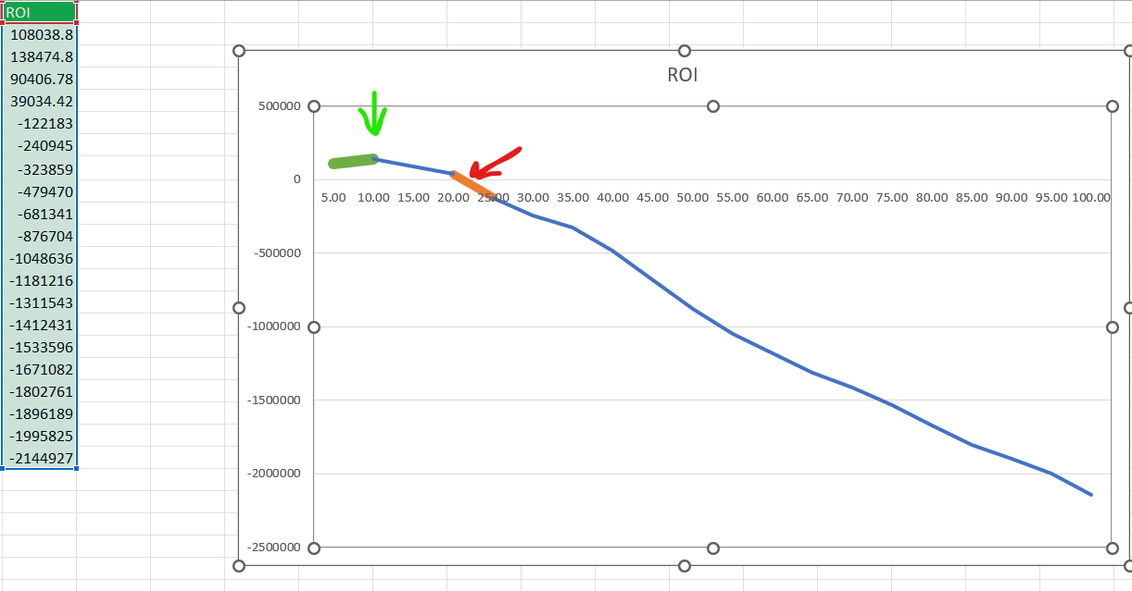
ROI of the model
The Return on Investment (ROI) indicates a positive trend. The ROI is projected to increase until it reaches 138,474 Euros, based on assumptions about the cost. After reaching this point, the ROI is expected to decline until it stops earning at 25% from the customers. It is important to note that the maximum return will come from 10% of the customers, indicating the potential for targeted marketing strategies.
ROI = Number of Customers X (Percentile from Table / 100) X (Imaginary Cost of Sending a Marketing cost per customer + Benefit from Purchasing New Digital Product per customer X Historical Percentage of Customers who Bought the New Product (19.22%) X Validation Lift)
Business Understanding
Exploratory data analysis (EDA)
Modelling
findings
Gain from actions

Slide 6
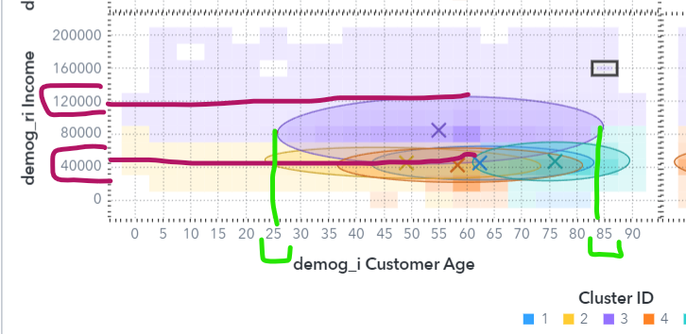
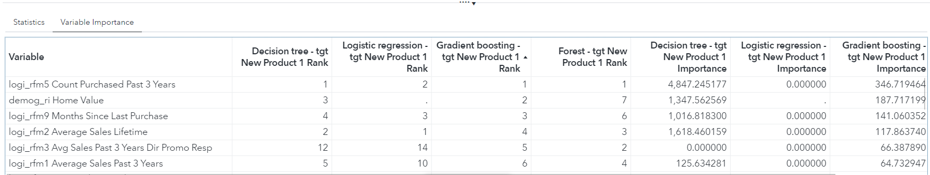
Findings
Impactful Variables: Count of purchases past 3 years
Home value 9 months since last purchase influence customer behavior. Customers’ Preferences: Targeting profiles include income, age, and employment status. Limitations: Lack of data on education, marital status, and field of work.
Business Understanding
Exploratory data analysis (EDA)
Modelling
findings
Gain from actions

Slide 7
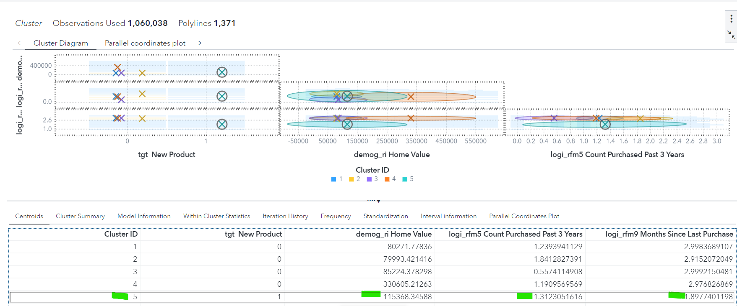
Who is the customer
Own Home with value starting with 115368 dollars.
Count purchased past 3 years around 1,31
Last purchased in the 9 months around 1,89
Primarily employed
Income between 40 k -100k
Business Understanding
Exploratory data analysis (EDA)
Modelling
findings
Gain from actions

Slide 8
Recommendations
For Marketing Management:
start targeting the Potential Customer group which identified with specific characteristics according to the Model in last slide
Think about targeting new group in age of digitalization who have :
income of less than $40,000 those under the age of 40, and students or individuals currently undergoing training before starting their job
der
Customer Segmentation: and in order to create the list of target accounts and their PERSONA I recommend to:
Define the marketing campaign budget
Collect additional data on education level, marital status, and field of work to refine customer segmentation
then I can provide you with list of the accounts according to the high potentially to respond
For C-Level
Positive ROI trend, but it needs to be optimized by defining the cost and incomes from the campaign Refine Data Set: Enhance data with education, marital status, and occupation for better segmentation. Focus on your Loyal customers with income between €40,000 and €100,000, primarily employed
Business Understanding
Exploratory data analysis (EDA)
Modelling
findings
Gain from actions

Slide 9
Innovativ intelligence solutions
Enhance Predictive Model: Improve the model for better accuracy.
Data Mining for Insights: Uncover valuable insights from demographic and social data.
Customer Data Maintenance: Keep customer data accurate and up-to-date. Optimize Business Value Chain: Streamline operations using data-driven approaches. Data-Driven Consultation: Provide insights to support strategic decision-making.
Business Understanding
Exploratory data analysis (EDA)
Modelling
findings
Gain from actions

